Slide 1
China Compulsory Certification (CCC) – Rising importance in trade compliance management and how enterprises should handle it
Raphael Madarang

Slide 2

Agenda
  CCC Overview
  Why is CCC important?
  Managing CCC exemptions
  Common issues and best practices
  APLL at a glance

Slide 3





CCC Overview
  CCC stands for China Compulsory Certification
  Started in 2002 with 132 articles and 19 product categories
  Aim is to safeguard the health & security of humans, animals & plants
  CCC grants permission to import, sell, and use a product
  CCC determines products safety, but does not constitute an endorsement or guarantee authenticity/quality
  Government authorities involved: AQSIQ, CNCA, CIQ
  AQSIQ - the General Administration of Quality Supervision, Inspection and Quarantine of the People's Republic of China
  CNCA - Certification and Accreditation Administration of the People's Republic of China
  CIQ - China Inspection and Quarantine Bureau

Slide 4
Why is CCC important? – Coverage and application
CCC catalog for 2015 comprises of 158 articles of 20 categories.
CCC catalog is adjusted annually (products/categories removed and added)
Detailed documentary requirements for certificate application
Long Lead time for certificate issuance – at least 90 days from application, type test, factory inspection, sample test, estimation and follow-up inspection to certificate issuance

Slide 5
Why is CCC important? – CCC Catalog
1 | Electrical wires and cables | 6 | Welding machines (incl. wire feeder and power supply) | 11 | Motor vehicles and Safety parts | 16 | Fire Fighting Equipment
2 | Switches for circuits, Installation protective and connection devices | 7 | Household and similar electrical appliances | 12 | Motor vehicle tyres | 17 | Detectors for Intruder Alarm Systems
3 | Low-voltage Electrical Apparatus | 8 | Audio and video apparatus | 13 | Safety Glasses | 18 | Wireless Local Area Network (WLAN) systems
4 | Small Power motors | 9 | Information technology equipment | 14 | Agricultural Machinery | 19 | Architectural decorative and fitting materials
5 | Electric tools | 10 | Lighting apparatus | 15 | Telecommunication terminal equipment | 20 | Toys

Slide 6
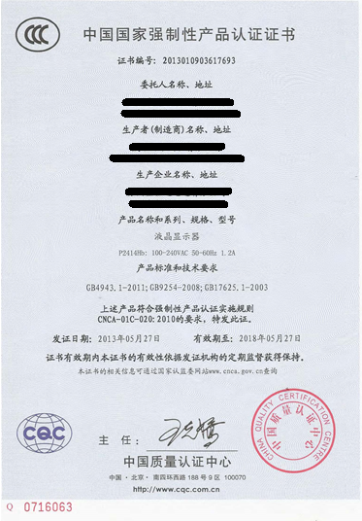
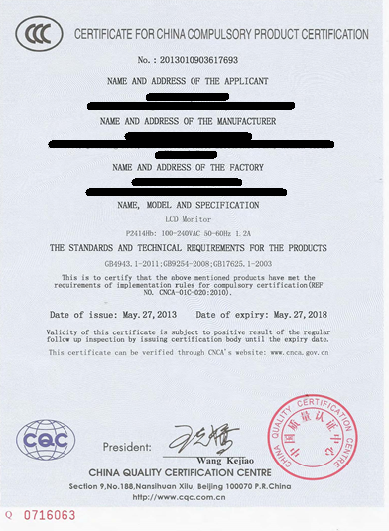
Why is CCC important? – CCC Sample

Slide 7

Managing CCC exemptions
  Donation among governments
  Personal belongings
  Goods used for exhibition
  Temporary import(repair, final destination Sha)
  Returned cargo exported from China
  Sample for CCC test
  Others
  Products in the catalog, but no certificate needed
  Upon CIQ examination
  and identification
  of specifications
  Products for research purposes
  Repairing products for end users
  Processing trade
  Exemption from CCC upon application, with approval by local CIQ
  HS code in the catalog, but CCC standard doesn’t apply to product specifications

Slide 8
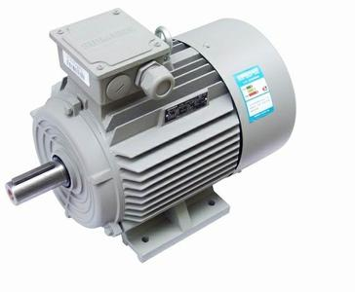
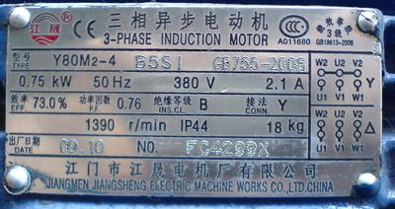
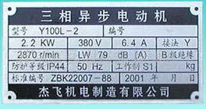
Managing CCC exemptions - Case study
but with max rated power 2.2 KW
  8501520000(motor)
  CCC standard: rated voltage above 36V, direct current within 1500V and alternating current within 1000V：
  When the revolution comes to1500 r/min, max continuous power is within 1.1 kW；
  Max continuous rated power is within 1.1 kW

Slide 9

  Common issues and best practices
  Issues
  Customers can not or are not willing to share product specifications
  Wrong specifications provided
  Cargo & certificate mismatch when inspected by CIQ

Slide 10
Common issues and best practices
  Issues
  Penalties
    Fine of RMB10,000 for improper use of CCC
    Fine of RMB 30,000 for avoiding, not obtaining a required certification

Slide 11
Common issues and best practices
  Best practices
  Detailed products specifications provided at the very beginning of CCC application
  Strong 3PL/engineering management of broker resource to support material verification
  FTZ solution
  Return solution

Slide 12
APLL at a glance
Over 60 Countries
Over 100 Service Locations
~6,000 Professionals
Auto
Retail
Consumer
Industrials

Slide 13
APLL at a glance – Tool box of services
ILS
Ocean (FCL / LCL)
132 thousand TEUs
Air
21mm kg (incl. managed)
Consolidation
1.1mm TEUs
Customs brokerage and broker compliance
150 thousand files
ITL
IndiaLinxSM
150 thousand TEUs
Intermodal domestic and US-Mexico
125 thousand Loads
Transport management
280 thousand Loads
CLS
Warehouse / RDC and distribution
~ 17mm square feet
High touch VAS
~ 100 sites globally
All
Solutions, Trade Compliance consulting and IT applications
~ 30 solution engineers

Slide 14
Thank you
Raphael_Madarang@apllogistics.com
852-23027436
Lily_Du@apllogistics.com
86-21-26105788

